Slide 1
Meiosis 1.0

Slide 2
Mitosis Review
Meiosis

Slide 3
Mitosis
Interphase- Cell Grows and DNA Replicates
G1- Cell makes proteins and gets bigger.
S- DNA Replicates
G2- Cell continues to grow, organelles duplicate.

Slide 4
Mitotic Phase- Mitosis & Cytokinesis
Prophase- Nucleus membrane dissolves, spindle
Metaphase-Chromosomes line up, spindles attach
Anaphase-Spindles rip chromosomes apart
Telophase-Nucleus reforms, spindles dissolve
Cytokinesis-cytoplasm divides making two identical cells.

Slide 5
INTERPHASE

Slide 6
Cytokinesis

Slide 10
All Cells
Mitosis happens in all cells except reproductive cells.
All cells except reproductive cells=Somatic cells
Reproductive cells= Gametes sperm, egg

Slide 11
Normal

Slide 12
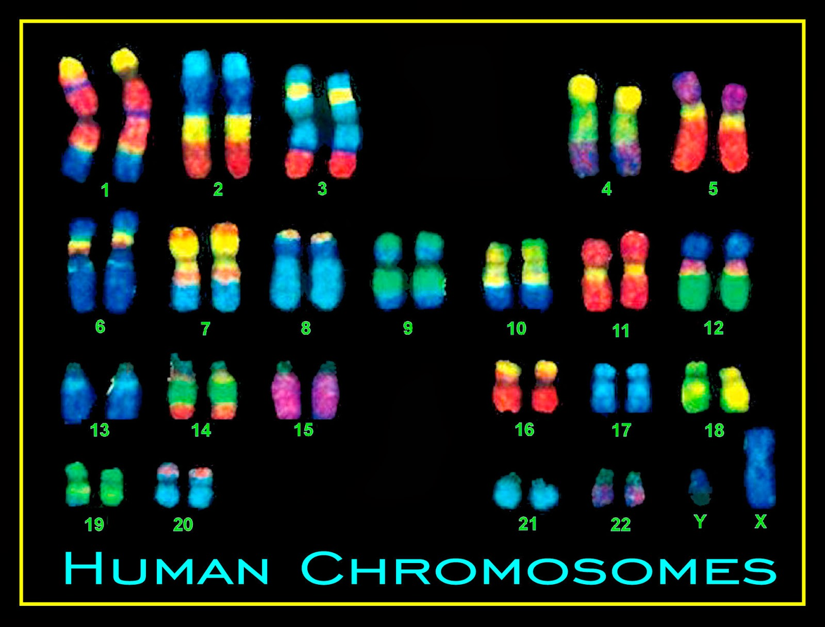
Homologous
Homologous Chromosomes- Chromosomes that are similar in size, shape, and genetic content.

Slide 15
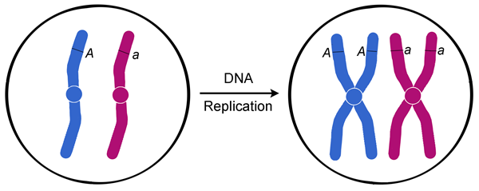
At Replication (S Phase)

Slide 16
Homologous Chromosomes

Slide 17
At Replication (S phase)=92 chromatids

Slide 18
Somatic Cells
All Somatic Cell are Diploid(2n)= 46 chromosomes. 23 from Mom: 23 from Dad

Slide 19
Sex Cells
All sex cells are Haploid(n)have only 23 chromosomes.
Sperm cell-23 Chromosomes
Egg cell- 23 chromosomes
Sperm+Egg= 46 Chromosomes…..You and I

Slide 20
Other words
Haploid Sperm Cell=23 Chromosomes
Haploid Egg Cell=23 Chromosomes
n+n= 2n
Haploid+Haploid=Diploid

Slide 21
When a sperm and an egg meet
Sperm(n) + Egg(n)= ZYGOTE(2n)
Zygote-a fertilized egg cell, the first cell of a new individual.

Slide 22
Baby Cell is a Zygote…Weird

Slide 23
Zygote Formation

Slide 24
Pg. 121 Blue Book
Table 1

Slide 25
Autosomes vs. Sex Chromosomes

Slide 26
Autosomes vs. Sex Chromosomes
Autosomes- 22 pairs(44 total chromosomes) contain genes that code for everything except SEX of the person.
Sex Chromosomes- 1 pair(2 total chromosomes) contain genes that code only for Sex of the person (male or female).

Slide 27
Sex of the Child
Dad- X Y
Mom- X X
Mom (X) & Dad (X)……..XX=Girl
Mom (X) & Dad(Y)………XY=Boy

Slide 28
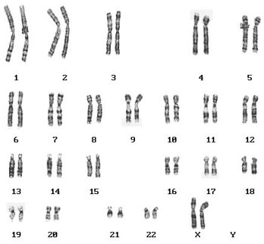
Karyotype
Karyotype- Array of chromosomes from Largest to
Smallest.

Slide 29
Anything Odd?

Slide 30
Trisomy 21

Slide 31
Trisomy 21
AKA- Down Syndrome

Slide 32
John Langdon Down (1866)

Slide 33
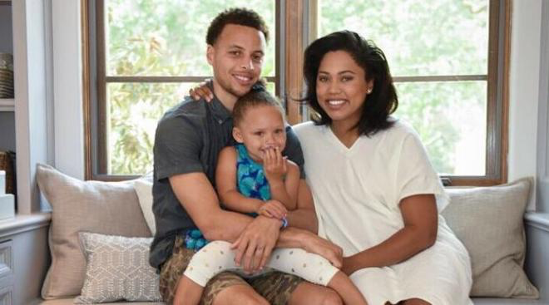
Asexual vs. Sexual Reproduction
Sexual Reproduction- Combining genetic material from two parents.

Slide 34
Asexual vs. Sexual Reproduction
Asexual Reproduction- produces offspring genetically identical to one parent.
*Cloning

Slide 35
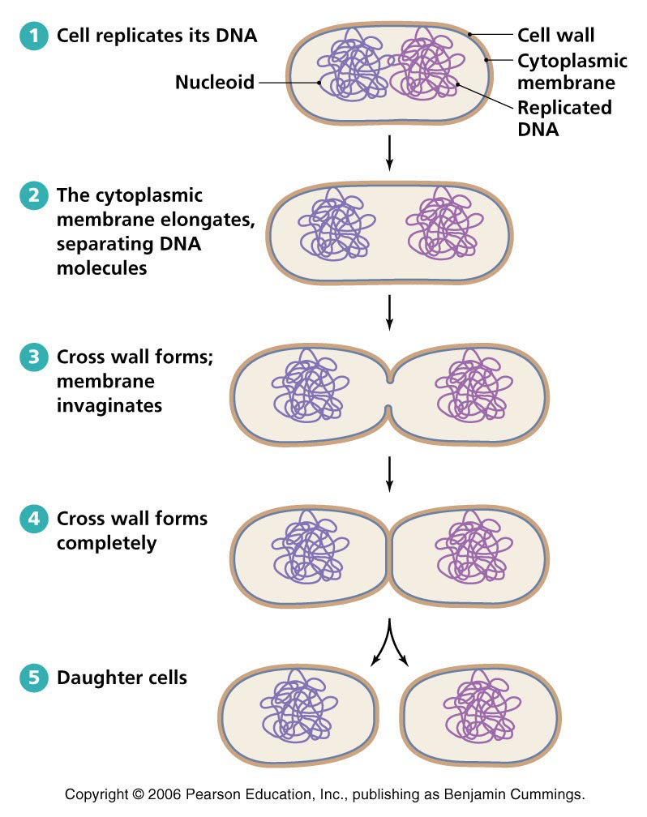
Asexual Reproduction Examples
Prokaryotic Cells(Bacterial) Binary Fission

Slide 36
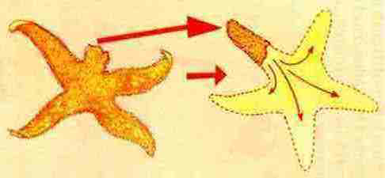
Asexual Reproduction Examples
Star-Fish

Slide 37
Asexual Reproduction Examples
Plants

Slide 38
Asexual Reproduction Advantages/Disadvantages
Advantages
1.One parent(rapid reproduction).
Disadvantages
No genetic variation
Evolve slowly

Slide 39
Sexual Reproduction Advantages/Disadvantages
Advantages
1.Unique combination of genes inherited
2. Results in greater genetic variation
3. Faster evolutionary processes
Disadvantages
1. Slower Rate

Slide 40
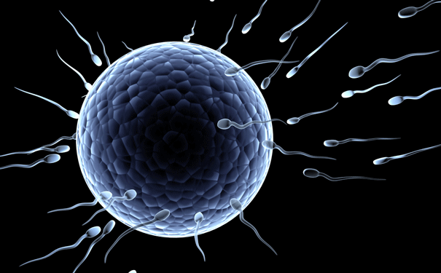
Meiosis
Meiosis- special type of cell division that produces gametes.
Egg
Sperm

Slide 41
Meiosis- two rounds of cell division without DNA replication.
Rule #1- When gametes are produced, number of chromosomes must be reduced by half.
Rule #2-Gametes end with 23 chromosomes, not 23 pairs.

Slide 42
Meiosis Steps
Start: - Diploid Cell(46 Chromosomes)
Interphase-Cell Grows, Copies it’s DNA into 92 chromosomes
Meiosis I- Crossing over, Homologous Recombination occur
Separate into two diploid cells.
Meiosis II-Two Diploid Cells
Result-

Slide 43
Purpose of Meiosis
1. Creates Genetic Variation
2. Make Haploid(n) gametes.

Slide 44
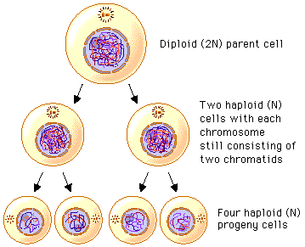
Stages & Result of Meiosis
Stage 1- Meiosis 1
Stage 2- Meiosis 2
Start: 1 Diploid(2n) cell
divide into
Result: 4 Haploid(n) cells

