Slide 1
Atmosphere 14.0
Severe Weather

Slide 2
Watch the Following Videos to answer the questions on your Atmosphere 14.0 paper

Slide 3
Video 1
https://youtu.be/QVZExLO0MWA

Slide 4
Video 2
https://youtu.be/fEiVi9TB_RQ

Slide 5
Thunderstorms: Thunder & Lightening

Slide 6
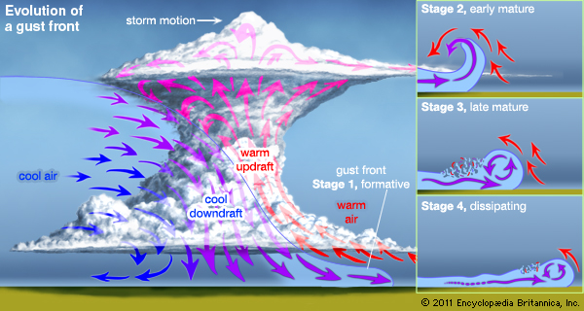
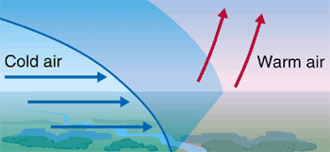
Thunderstorms: where they occur
Along cold fronts

Slide 7
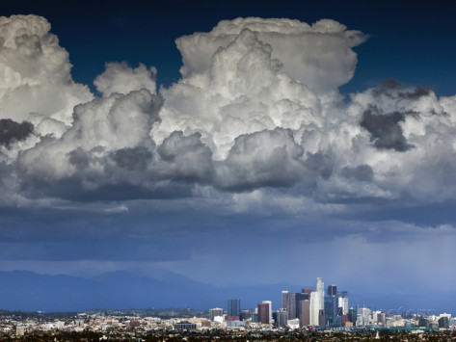
Thunderstorms: Thunder & Lightening
Lightening occurs from collected electricity within cumulonimbus clouds.

Slide 8
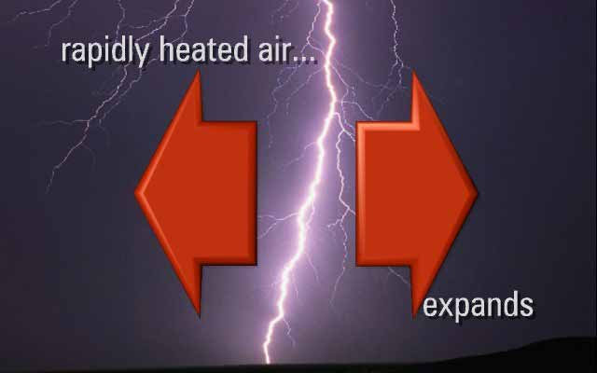
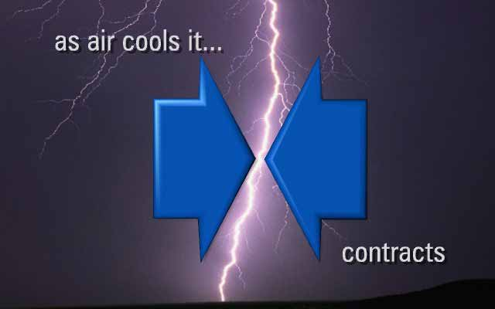
Thunderstorms: Thunder & Lightening
Thunder is caused by rapidly heated air around lightening strikes. This produces a clap like sound.

Slide 9
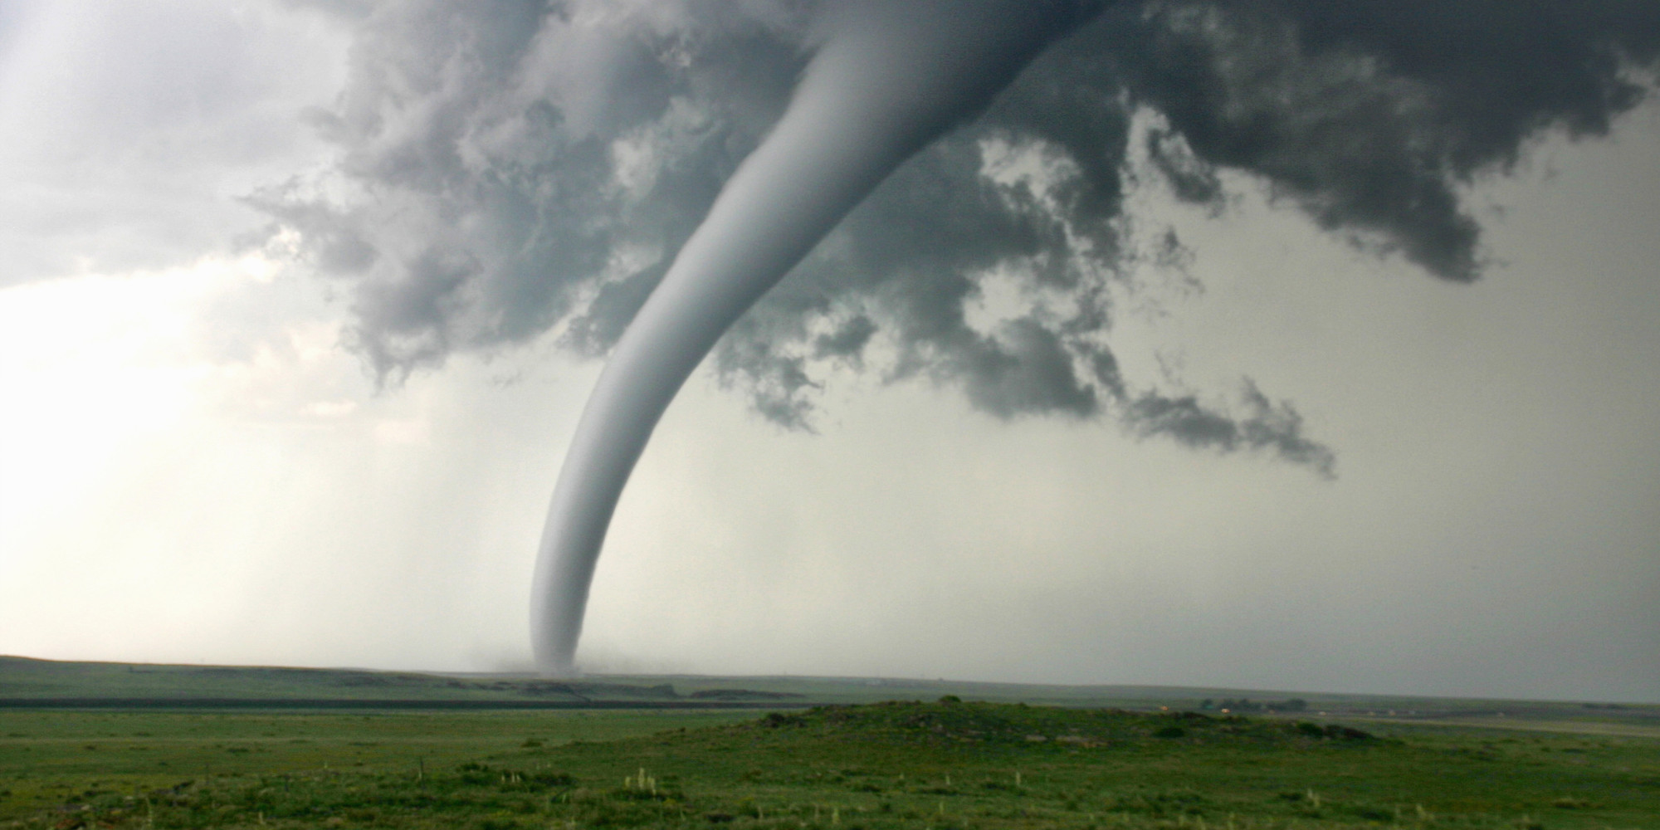
Tornadoes- Characteristics
Form at front of severe thunder storms
Usually last a few minutes

Slide 10
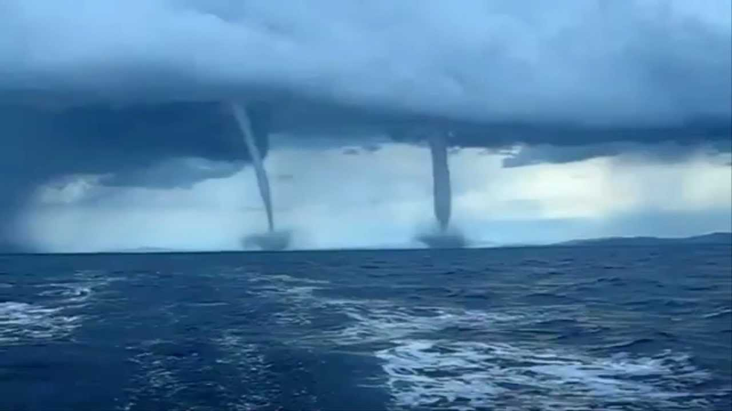
Tornadoes over water
Tornadoes over water are called water spouts

Slide 11
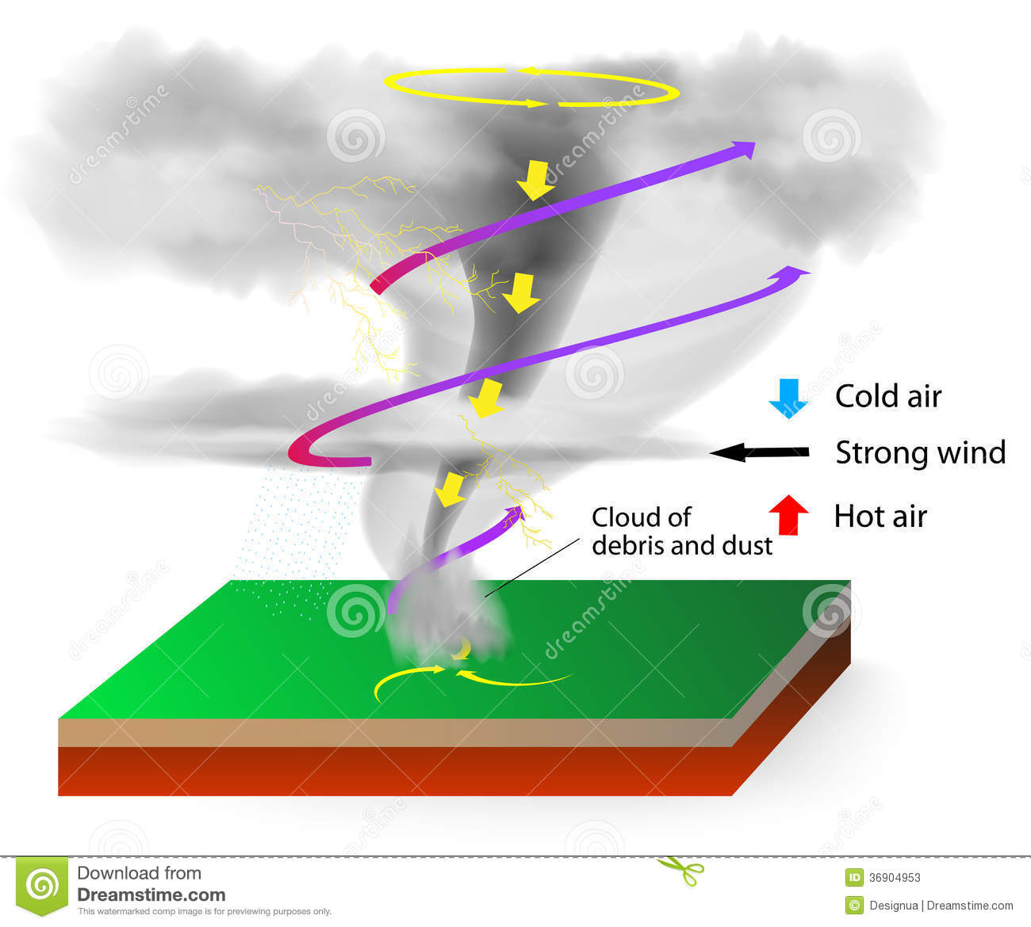
Tornadoes- Formation
As warm air in thunderstorms rise, cool air rushes in to take its place.
This forms a funnel shaped whirling column of air that extends form the earth to the thunder cloud.

Slide 12
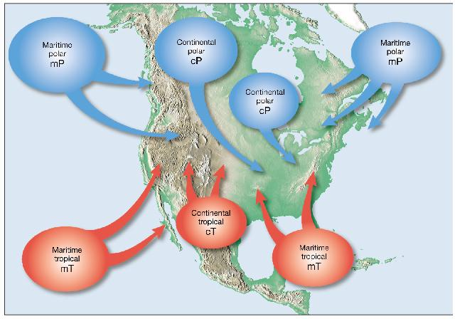
Tornadoes location
Where maritime tropical and continental polar air masses meet…usually the spring.

Slide 13
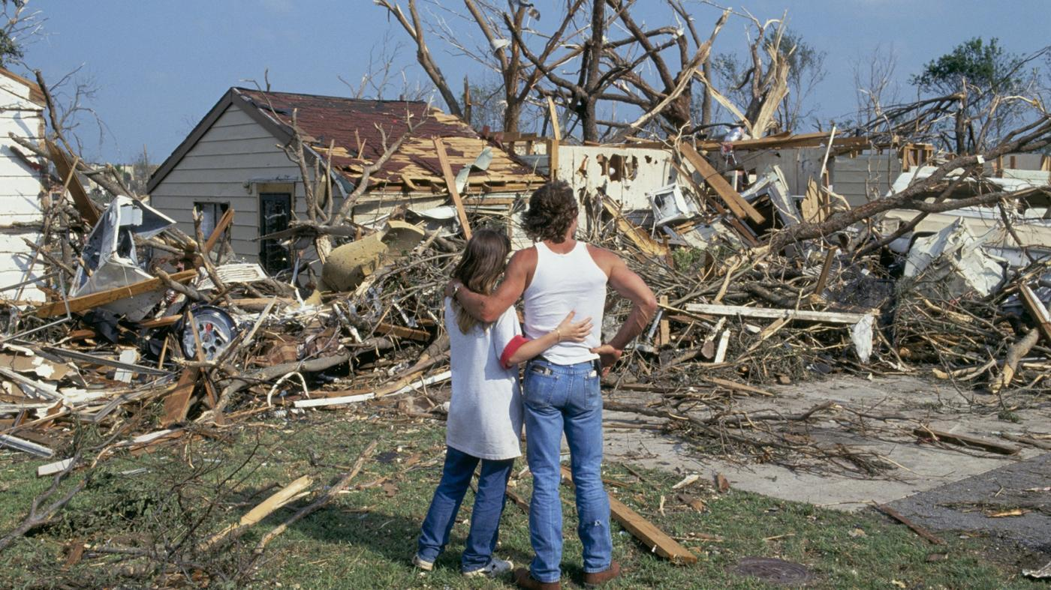
Tornadoes damage
Can destroy everything in its path.
Average of 90 people are killed by tornadoes each year.

Slide 14
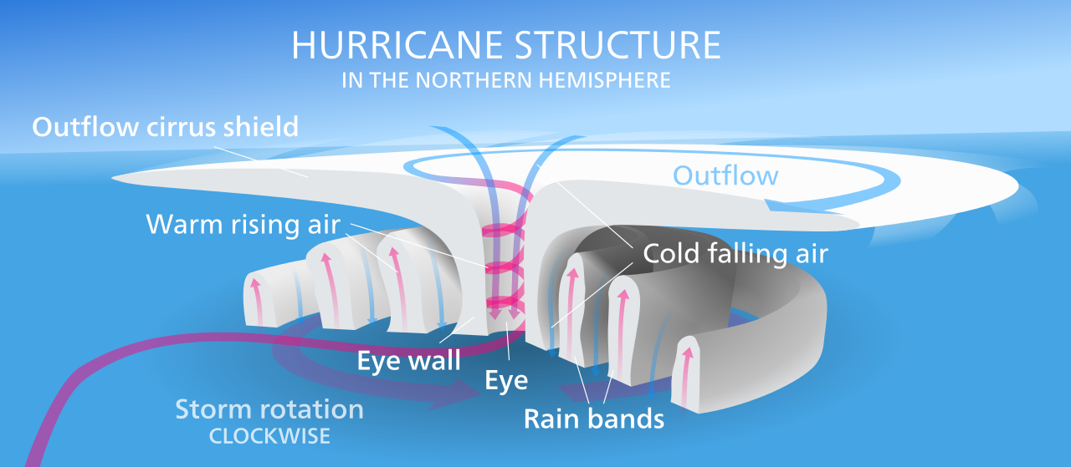
Hurricanes- Formation
Form over warm seas
Warm air rises and creates a tropical depression. Air begins to rotate around this.

Slide 15
Hurricane

Slide 16
Blizzard- Conditions
Temperatures below 20º F
Winds greater than 35 mph
Forms over middle latitudes and toward the poles

Slide 17
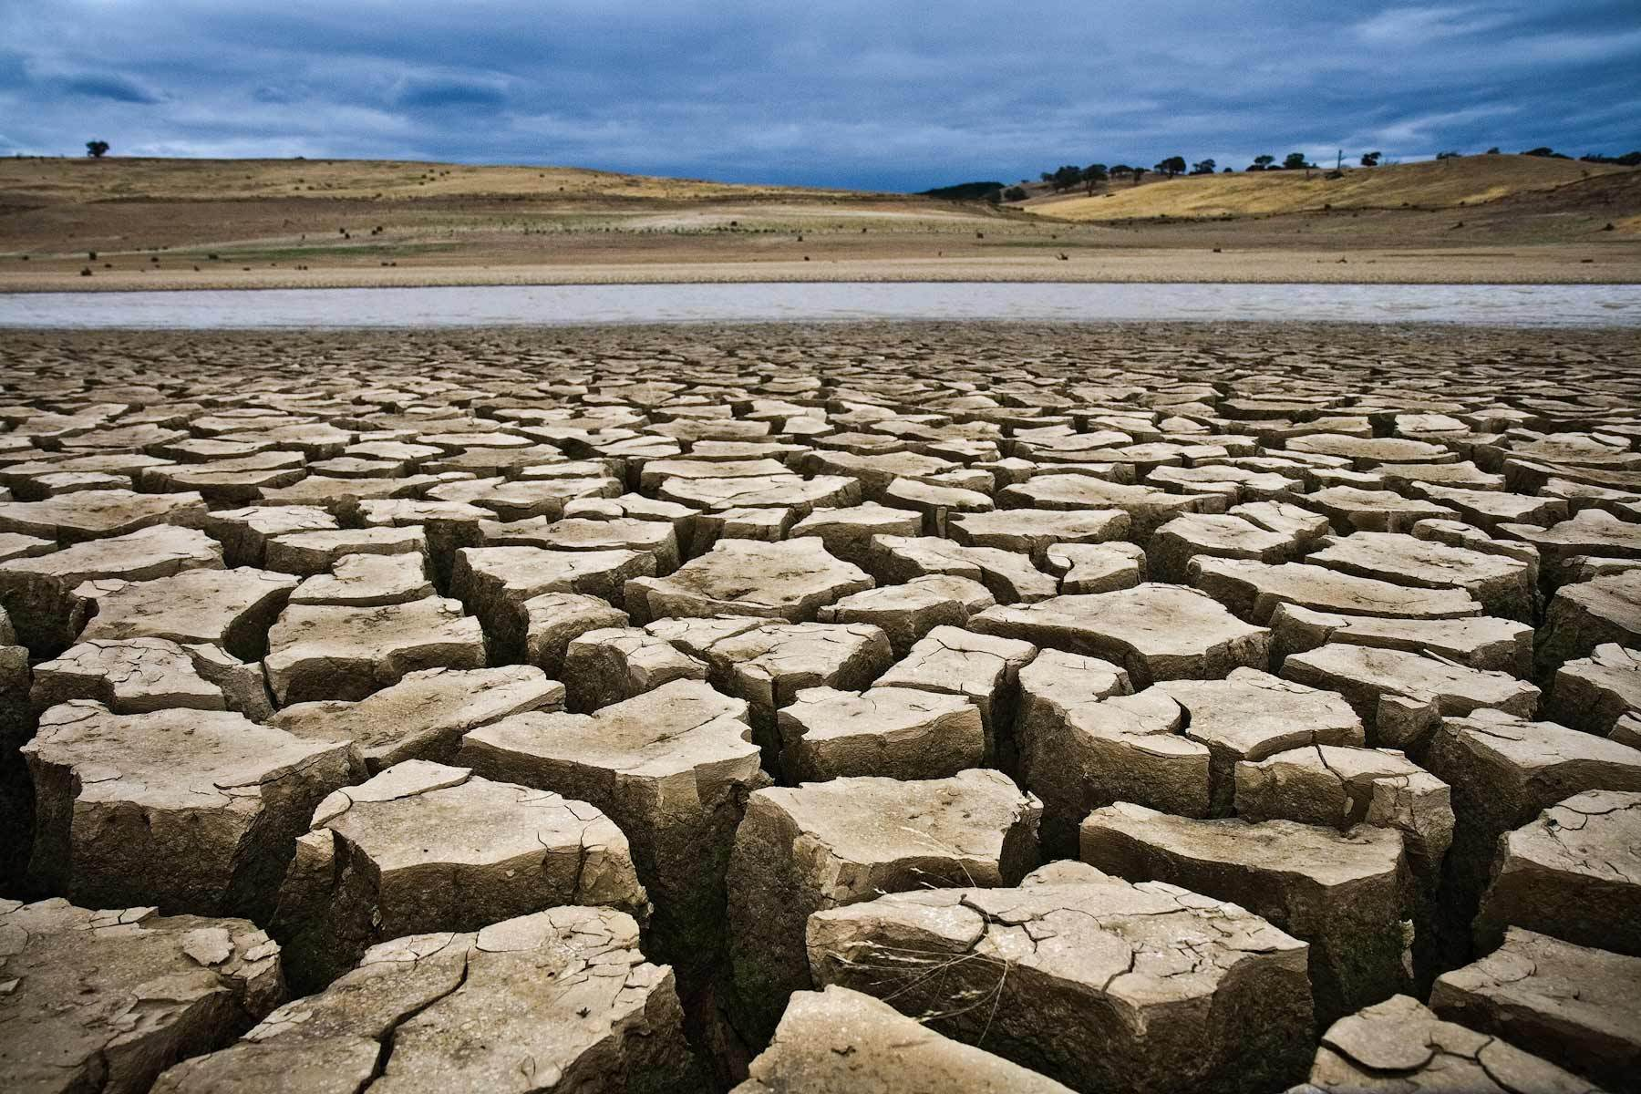
Drought- negative effects
Very little precipitation for an extended period of time

Slide 18
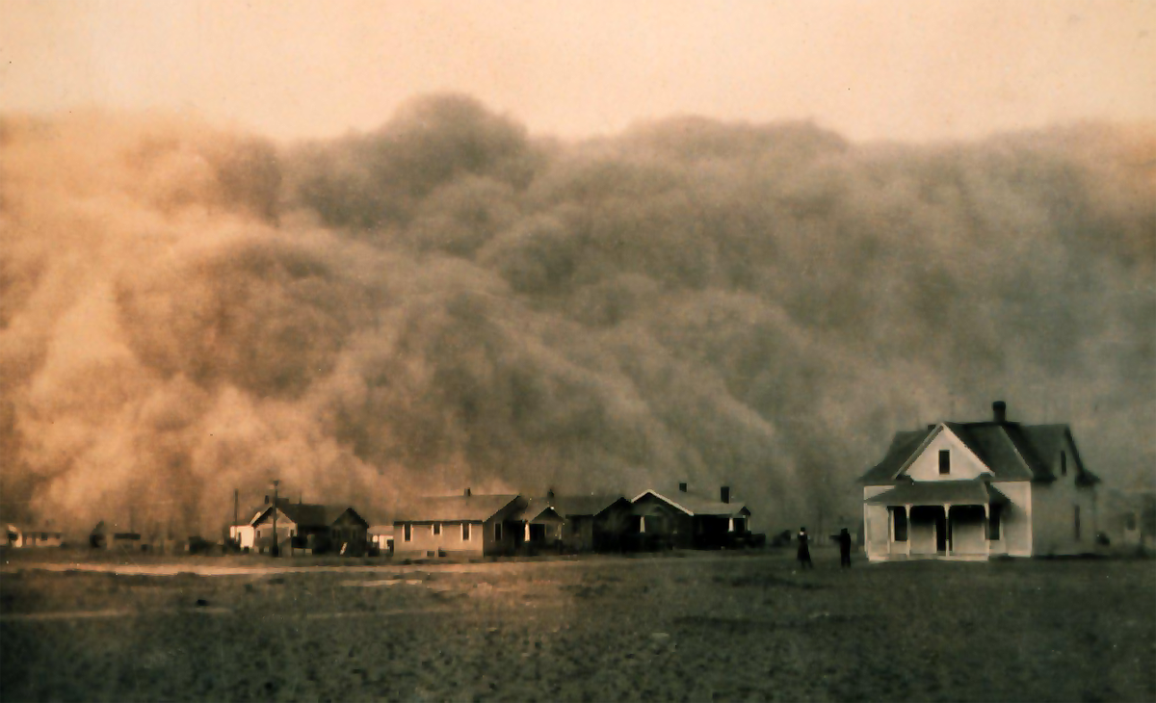
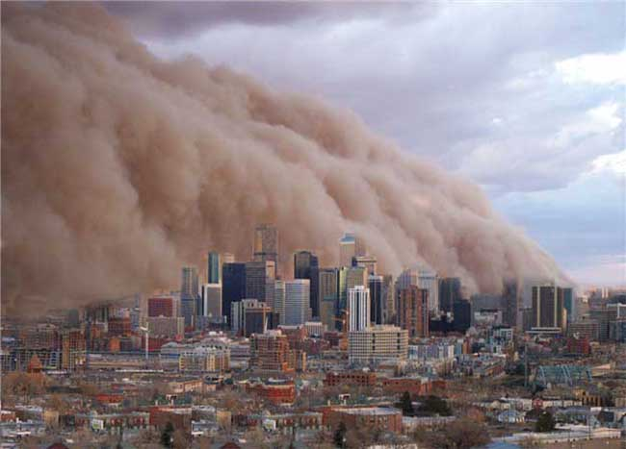
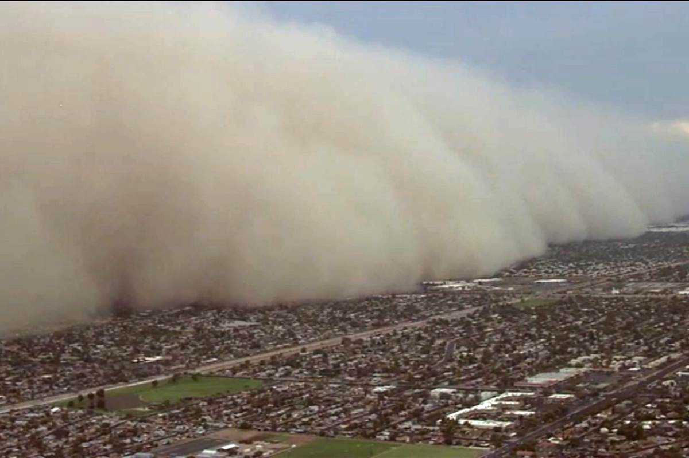
Drought- consequences
Ruined fertile soil
Wildlife disturbance
Dust storms

Slide 19
All Done
Please read or sit quietly …work on something new.

